Slide 1

TRATTAMENTO COMBINATO PRE E POST OPERATORIO E WEIGHT RECURRENCE
Prof. Luigi SCHIAVO, PhD, FACN
Professore Associato di Scienza dell’Alimentazione e delle Tecniche Dietetiche Applicate
Dipartimento di Medicina, Chirurgia e Odontoiatria
Università degli Studi di Salerno
DELEGATO AREA NUTRIZIONALE E SOCI AFFINI SICOB (Campania)

Slide 2
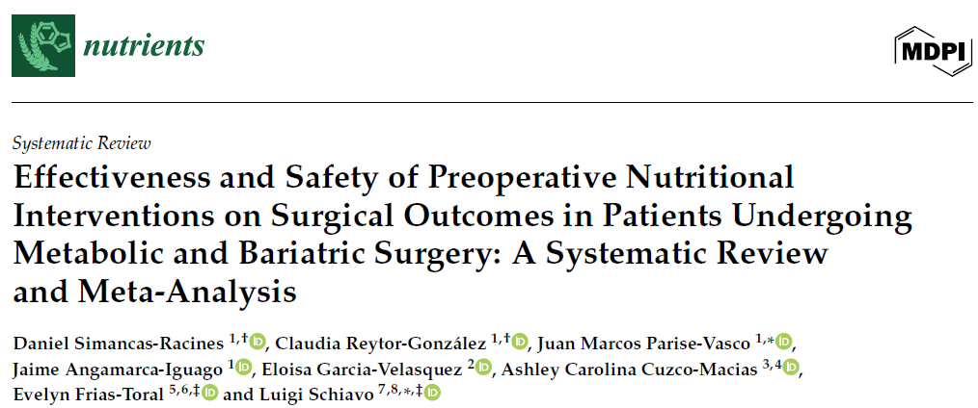
2025, 17, 1533
We aimed to evaluate:
perioperative complications
operative time
length of hospital stay
Eight trials comprising 1197 patients were included in the meta-analysis

Slide 3
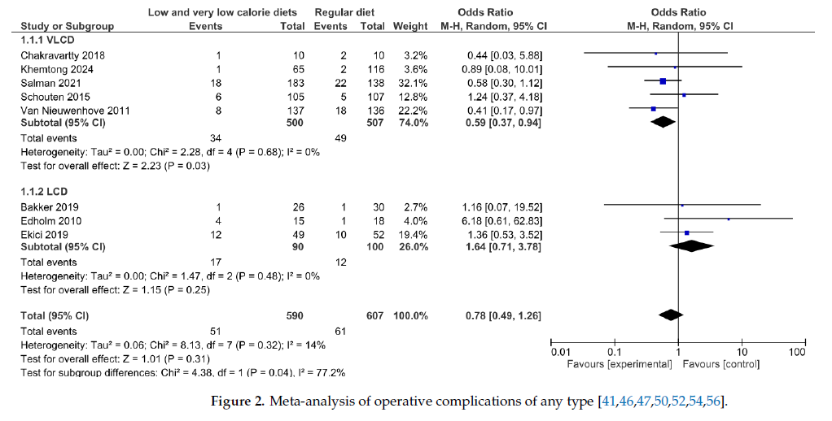
VLCDs were associated with a significant reduction in perioperative complications (OR 0.59; 95% CI: 0.37–0.94; p = 0.03), whereas LCDs showed no significant effect on complications (OR 1.64; 95% CI: 0.71–3.78; p = 0.25)

Slide 4
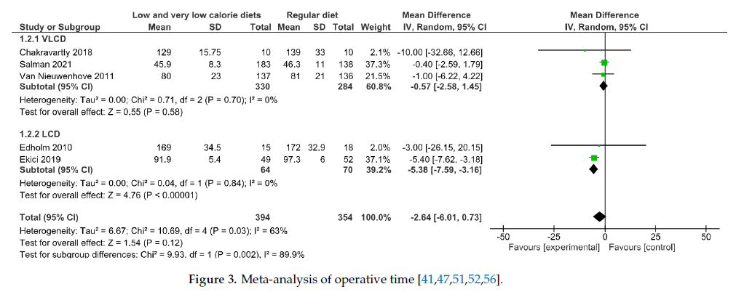
No significant reduction in operative time was observed (MD −2.64 min; 95% CI: −6.01 to 0.73; p = 0.12)

Slide 5
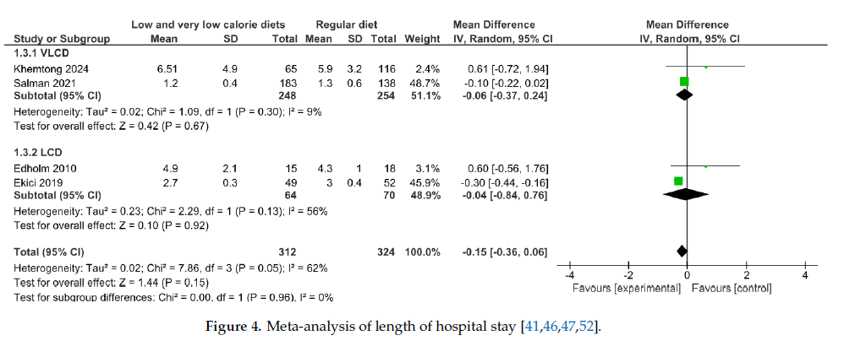
Hospital stay was slightly reduced (MD −0.17 days; p = 0.0001)

Slide 6
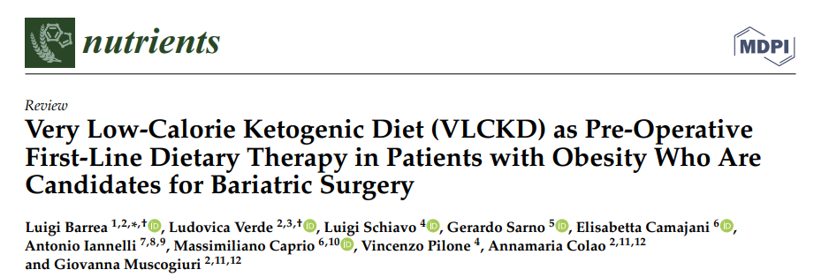
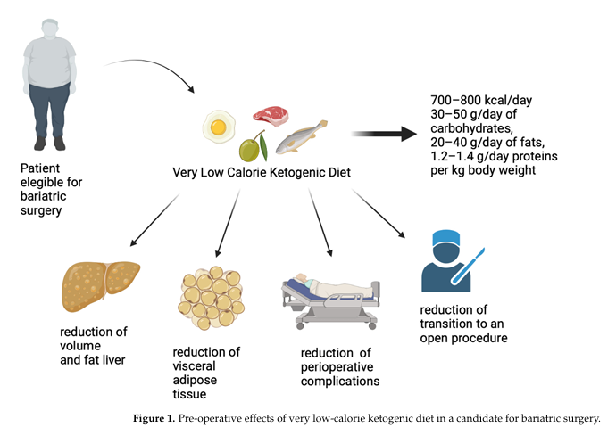
2023, 15, 1907
Low Energy Ketogenic Therapy have demonstrated efficacy in:
promoting preoperative weight loss, preserving FFM and RMR
decreasing waist circumference and liver volume
facilitating bariatric surgery.
reduce perioperative complications

Slide 7
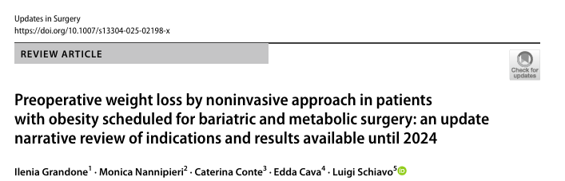
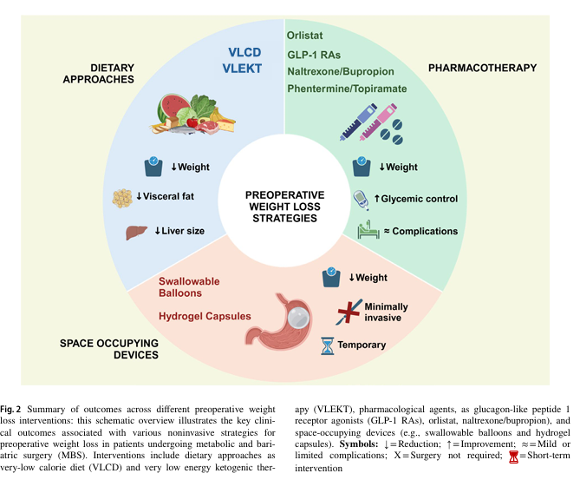
2025 Apr 12
The use of pharmacotherapy in the pre-bariatric surgery setting is gaining attention, as it may:
promoting preoperative weight loss
Improving glycemic control
reduce perioperative complications
although it is still underutilized

Slide 8
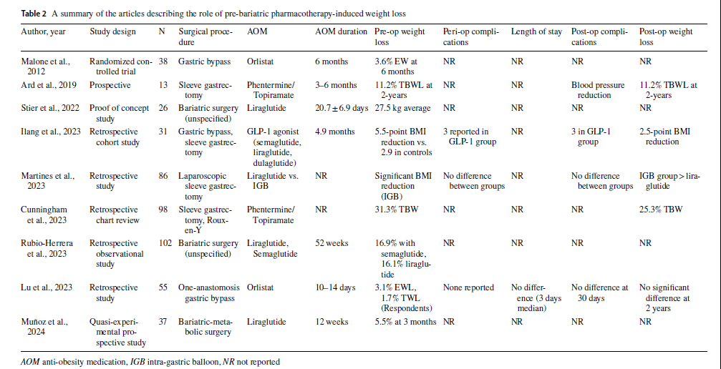
Obesity management medications, such as orlistat, phentermine/topiramate, naltrexone/bupropion, liraglutide, semaglutide, and tirzepatide, has shown to be effective in promoting PreopWL before MBS; however, larger, well-designed RCTs are needed to establish optimal treatment protocols and assess their true benefits in patients scheduled for MBS.

Slide 9
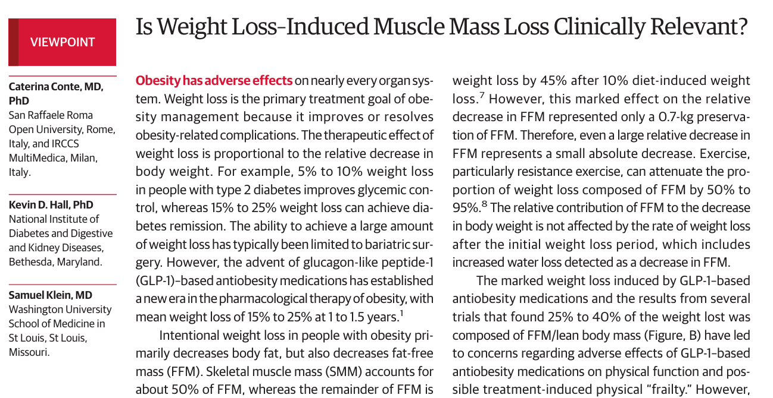
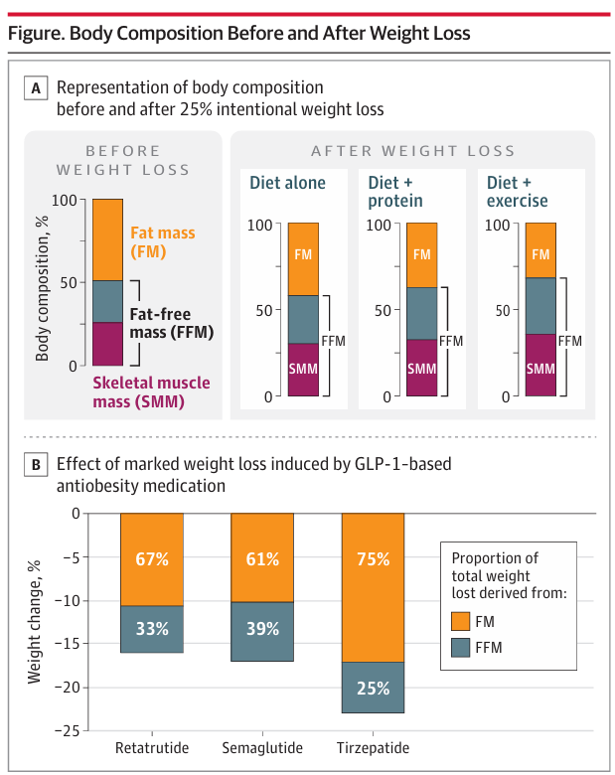
TITOLO SLIDE
JAMA July 2, 2024 Volume 332, Number1
Several trials found 25% to 40% of the weight lost was composed of FFM have led to concerns regarding adverse effects of GLP-1–based anti-obesity medications on body composition changes
1:3

Slide 10
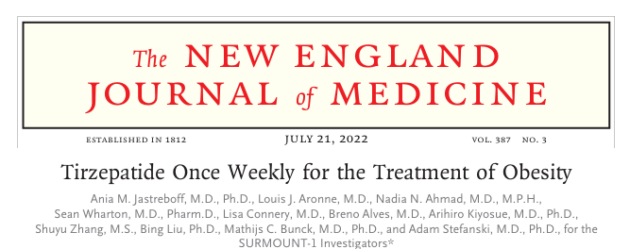
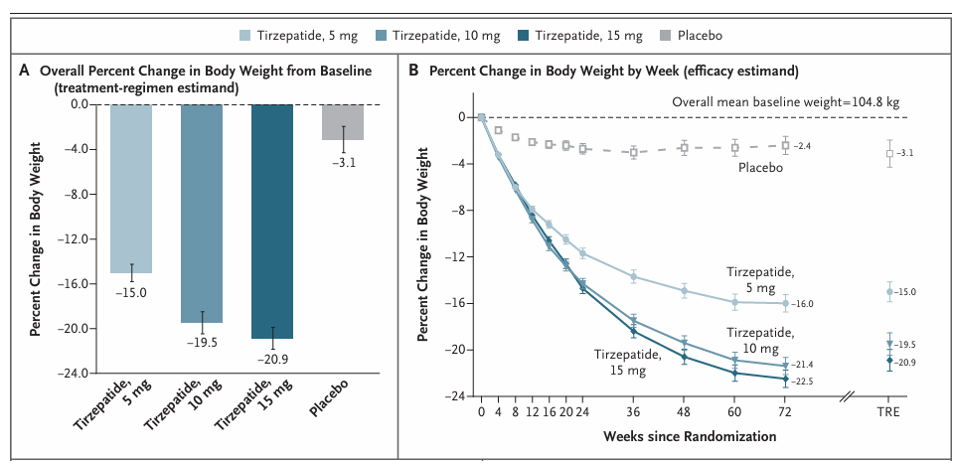
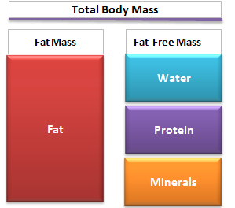
LCD = - 500 calories per day
33.9%
10.9%

Slide 11
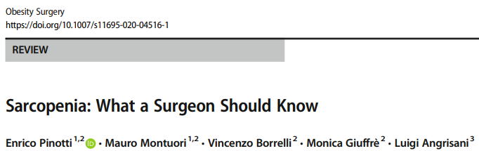
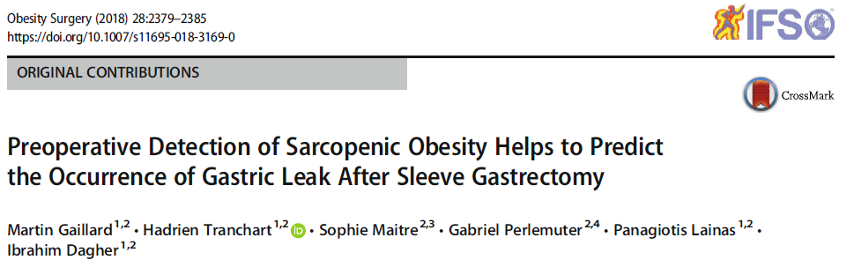
When a sarcopenic patient undergoes major surgery, it has a higher risk of postoperative complications because of less resistance to surgical stress.
In this series, the risk of the gastric leak was 9.1% in sarcopenic patients and 2.2% in non-sarcopenic patients (p = 0.032)
Therefore, preventive measures should be implemented early during preoperative weight loss with OMM therapy to mitigate FFM loss

Slide 12
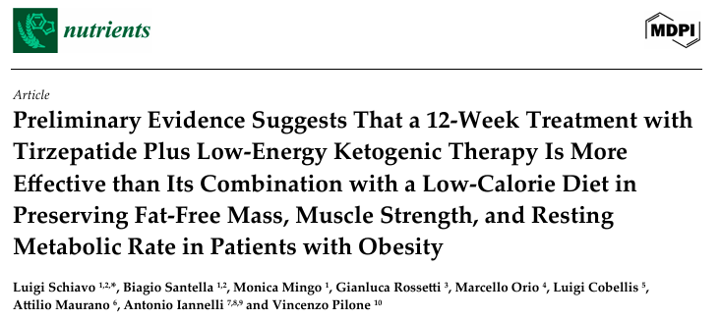
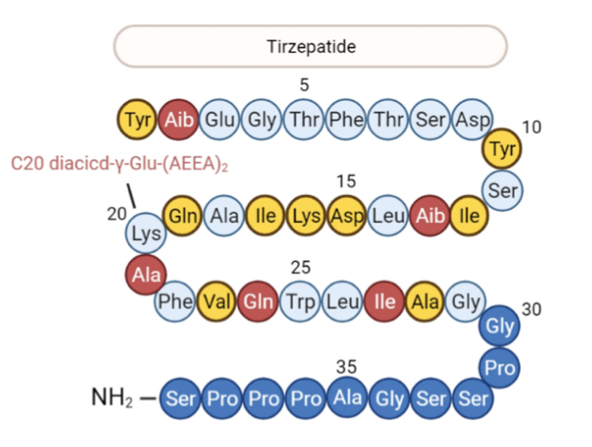
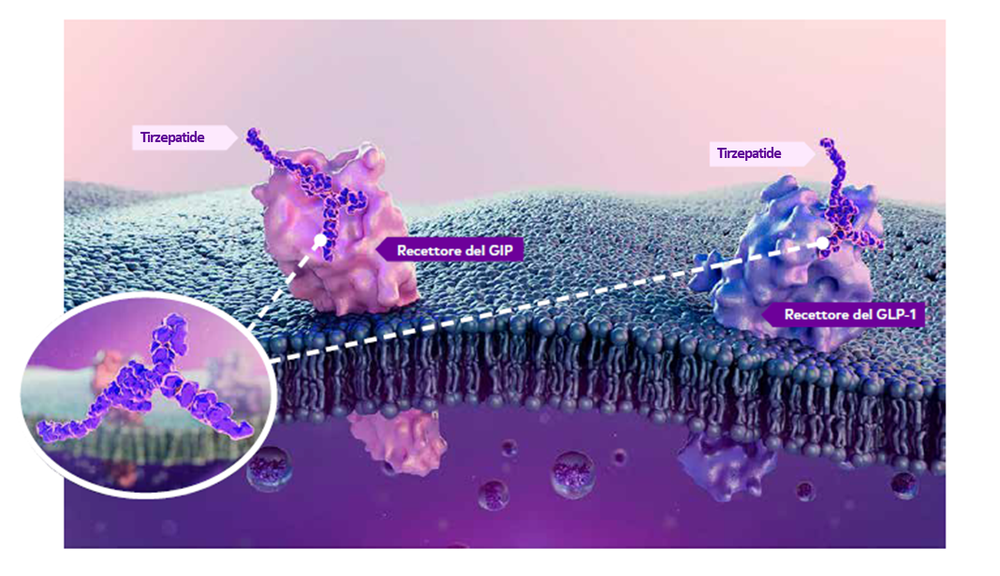
2025, 17, 1216

Slide 13
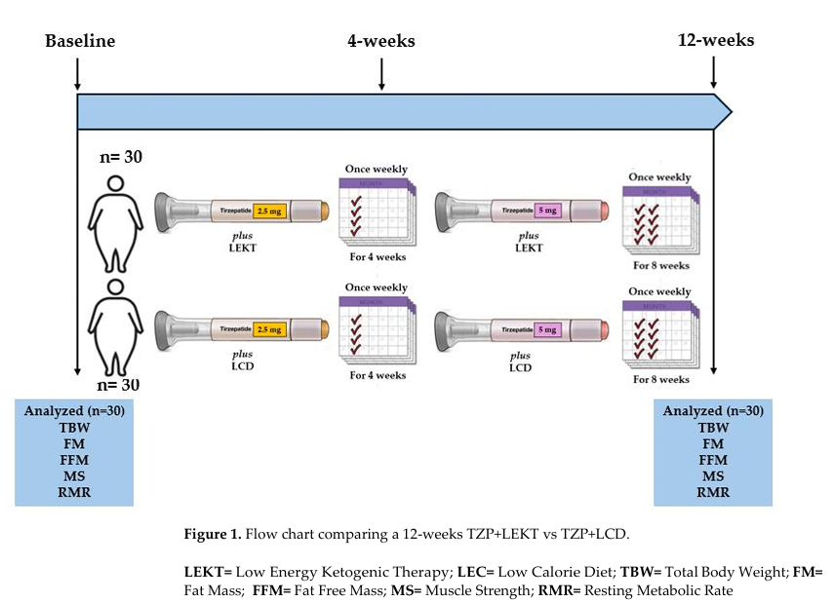
Flow chart comparing a 12-week TZP+LEKT vs TZP+LCD
<30 gr carbohydrates/day
LCD (as Surmount-1)
50% carbohydrates
30% protein
30% fat
1200 kcal/day

Slide 14
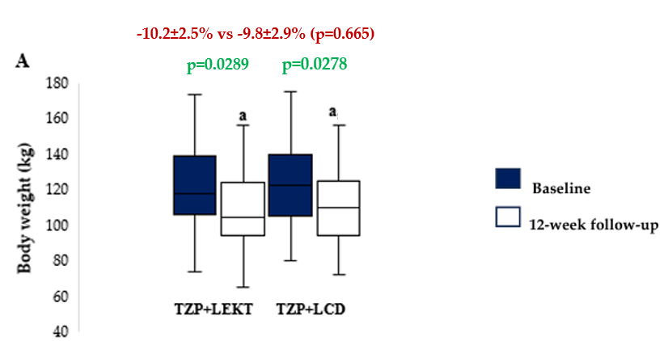
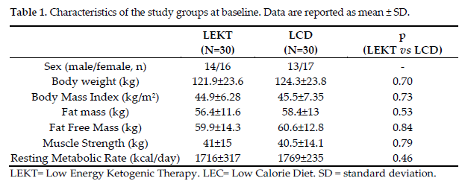
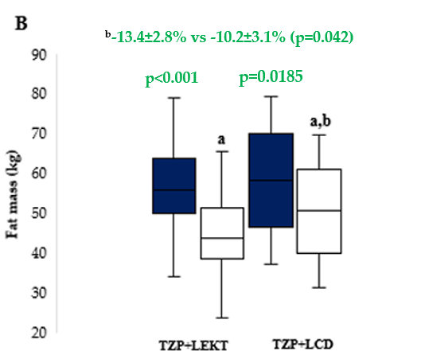
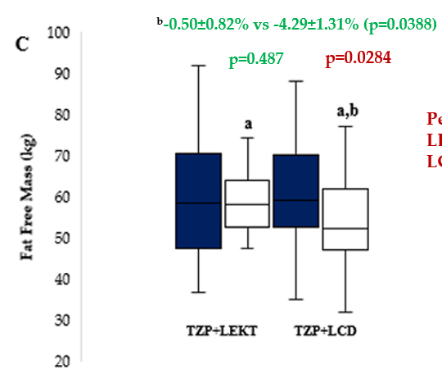
RESULTS
Figure 2. Box plots showing baseline and 12-week follow-up changes in body weight (A), fat mass (B), and fat free mass (C) in both groups study. The horizontal bars represent the median values. Lower and upper boundaries of the box represent the first and the third quartile, respectively. Lower and upper error bars represent the minimum and the maximum value, respectively.
ª12-week follow-up vs baseline
^{b}12-week follow-up TZP+LEKT vs LCD

Slide 15
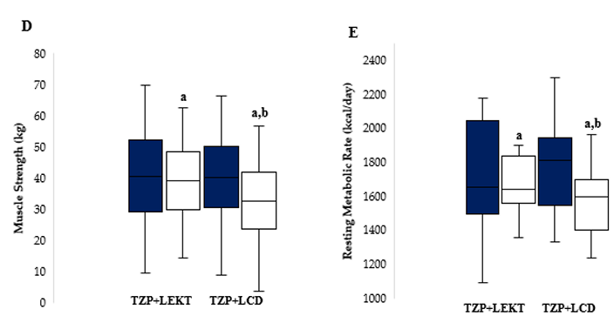
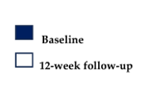
RESULTS
^{b}-0.3±0.9% vs -4.1±1.2% (p=0.046)
^{b}-1.2±0.9% vs -5.3±1.8% (p=0.019)
p=0.691
p=0.0341
p<0.001
p=0.263
Figure 2. Box plots showing baseline and 12-week follow-up changes in muscle strength (D) and resting metabolic rate (E) in both groups study. The horizontal bars represent the median values. Lower and upper boundaries of the box represent the first and the third quartile, respectively. Lower and upper error bars represent the minimum and the maximum value, respectively.
ª12-week follow-up vs baseline
^{b}12-week follow-up TZP+LEKT vs LCD

Slide 16
SURMOUNT 1 STUDY ANALYSIS AT 12 WEEK
LCD = - 500 calories per day
72w
72w
33.9%
10.9%
12w
12w
8.5%
vs
13.4%
our study (LEKT)
1.9%
vs
0.5%
our study (LEKT)

Slide 17
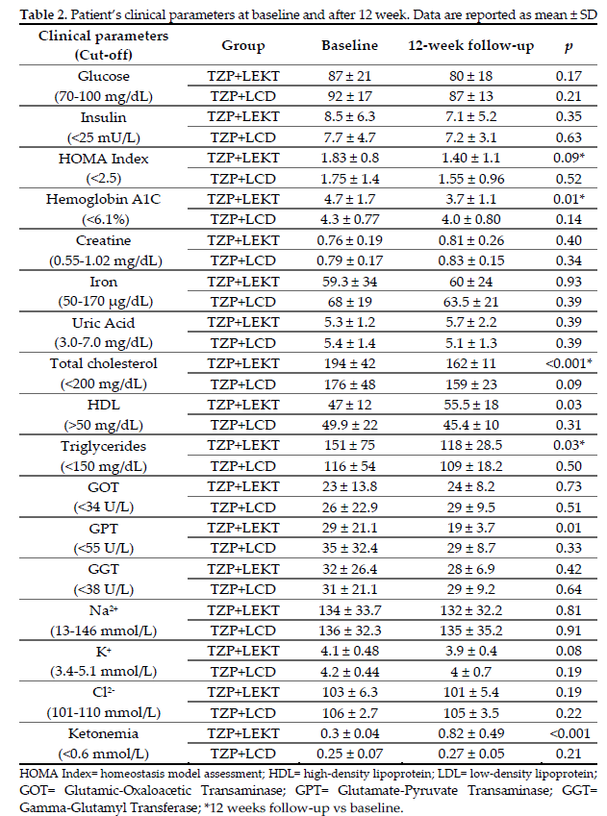
RESULTS

Slide 18
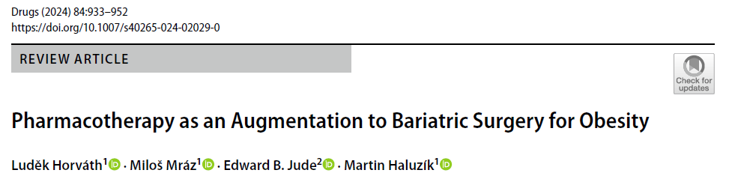
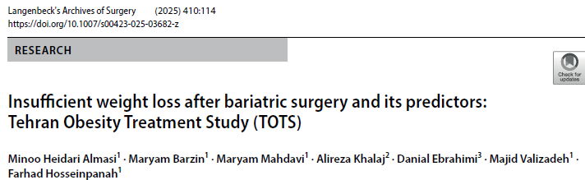
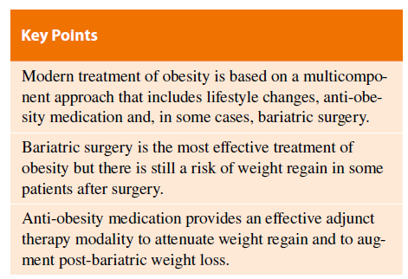
Approximately 15–30% of bariatric surgery patients experience significant IWL (defined as less than 50% excess weight reduction).
(20–25%)
Generally, research on the use of prescription weight loss medications to treat IWL or WR is scarce and is primarily retrospective, and no studies were powered to determine the best medication/s or timing of introduction of the medication

Slide 19
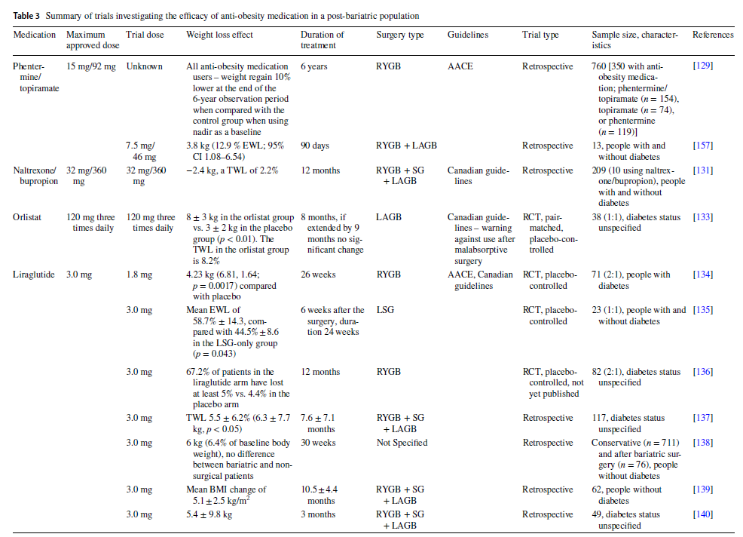

Slide 20
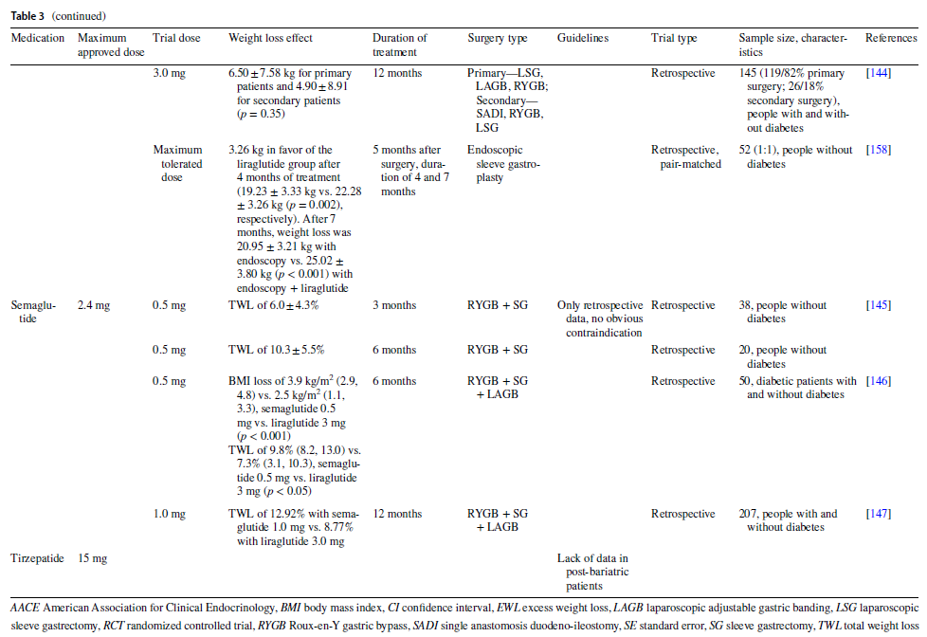

Slide 21
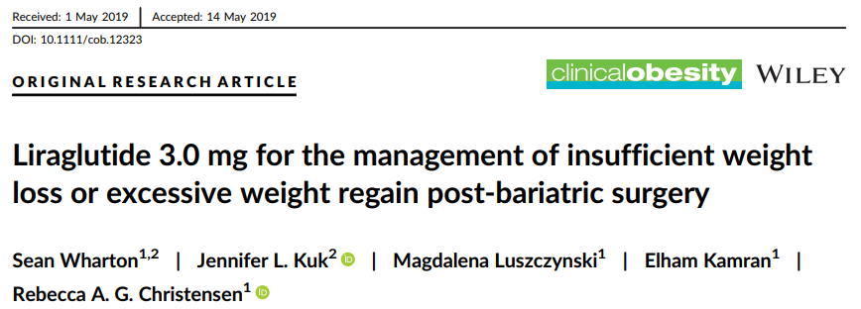
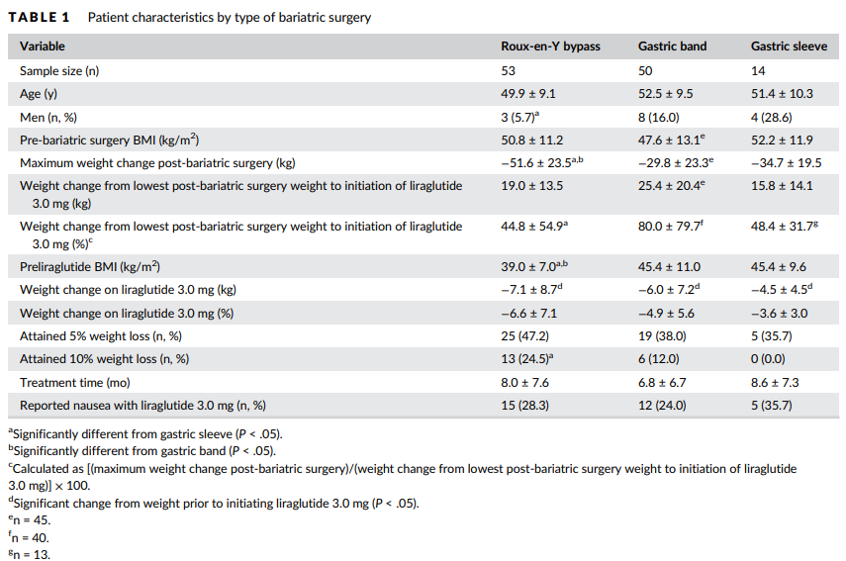
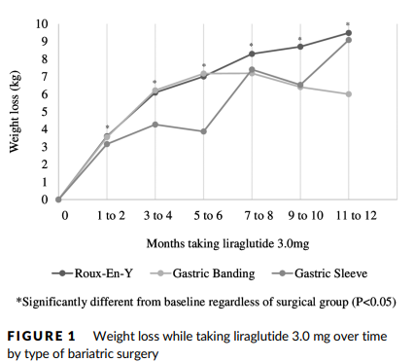
Over 7.6 ± 7.1 months taking liraglutide 3.0 mg, patients lost a statistically significant amount of weight (−6.3 ± 7.7 kg, P < .05) regardless of the type of surgery they had (P > .05)

Slide 22
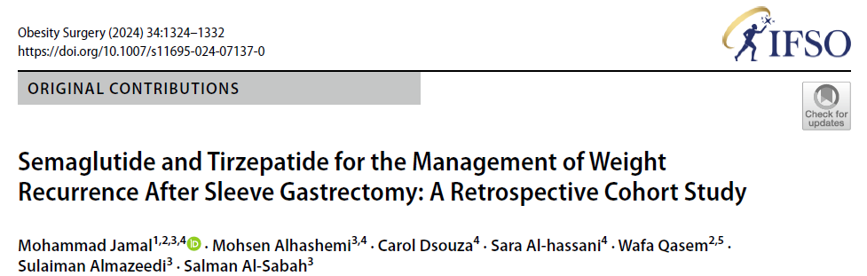
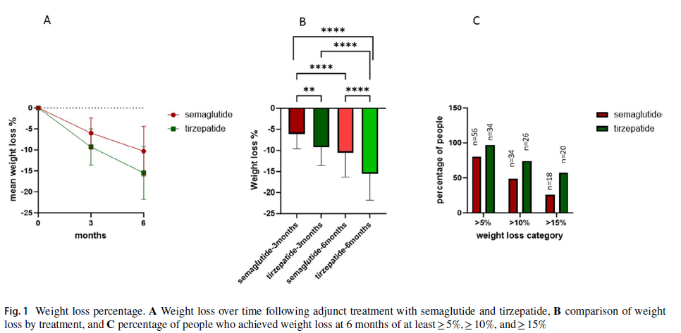
A total of 115 patients were included, of which 70 had SG and treated for weight recurrence with semaglutide and 45 had SG and treated with tirzepatide.
Weight loss in tirzepatide patients was significantly greater than the semaglutide patients at 6 months (p < 0.02).

Slide 23
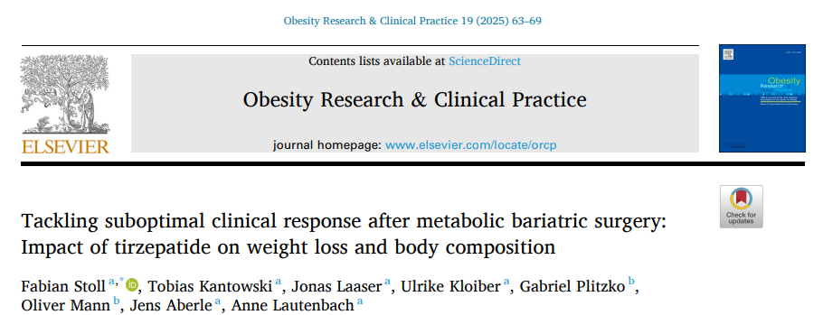
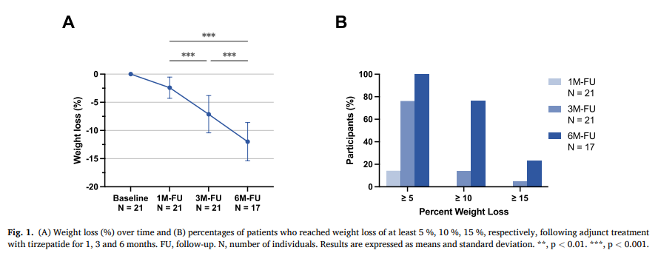
Post-bariatric patients without type 2 diabetes with IWL or WR (n = 21) were analyzed
At 6 months, mean total weight loss was 12.0 % ± 3.4 % (p < 0.001).

Slide 24
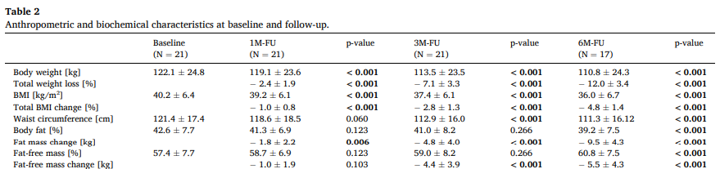
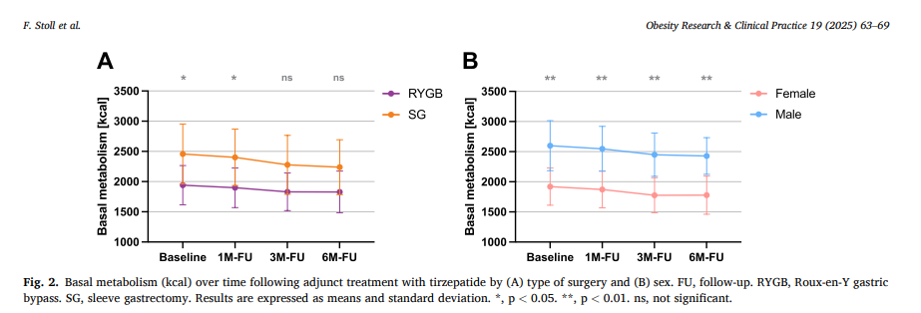
Fat Free Mass and Basal metabolism declined proportionally with weight loss.
Tirzepatide treatment significantly enhances weight loss and metabolic health in post-bariatric patients.
Decline in fat-free mass and basal metabolic rate highlight the need for tailored interventions in IWL and WR groups

Slide 25
Conclusions and Take Home Message
Bariatric surgery is the most effective modality of treatment for both obesity and its associated comorbidities.
Anti-obesity medications have an established place in the obesity treatment algorithm, both as a second-line therapy after lifestyle modifications and as neoadjuvant therapy before bariatric surgery, to achieve the necessary pre-bariatric weight loss.
Weight regain after bariatric surgery or insufficient weight loss after the operation occurs in all types of bariatric surgery.
Some data point to a possibility of effective use of anti-obesity medication, especially in patients with insufficient weight loss rather than weight regain after bariatric surgery
Research on the use of prescription weight loss medications to treat IWL or WR is scarce and is primarily retrospective, and no studies were powered to determine the best medication/s or timing of introduction of the medication

Slide 26


